Slide 1
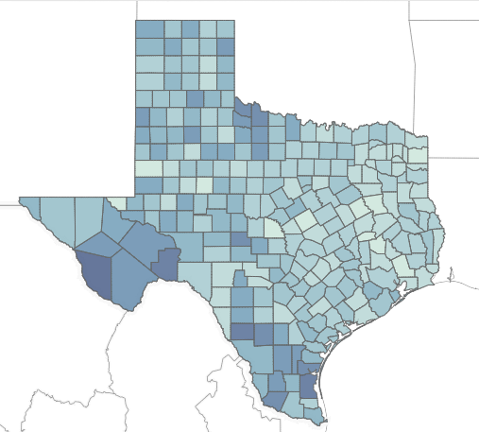
Texas COVID-19 Vaccine Allocation and Distribution Analysis: By: Tyler Mann

Slide 2
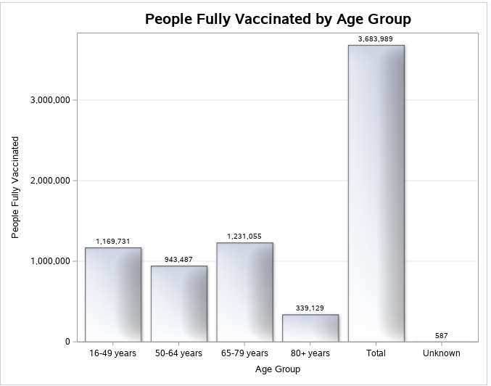
The distribution of people by age group that are fully vaccinated is evenly distributed across age groups based on population.

Slide 3
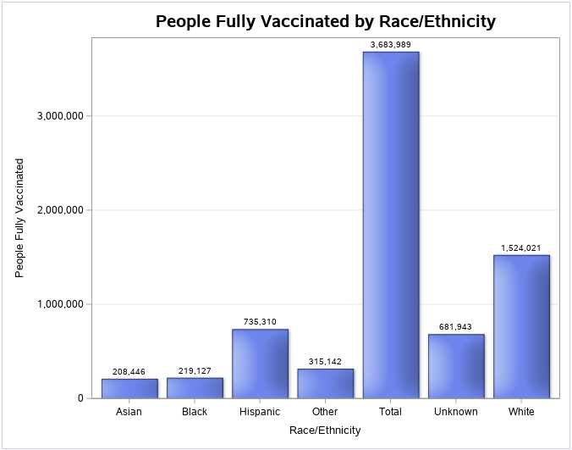
Those that are fully vaccinated based on race/ethnicity shows a more disproportionate view for those who are non-white.

Slide 4
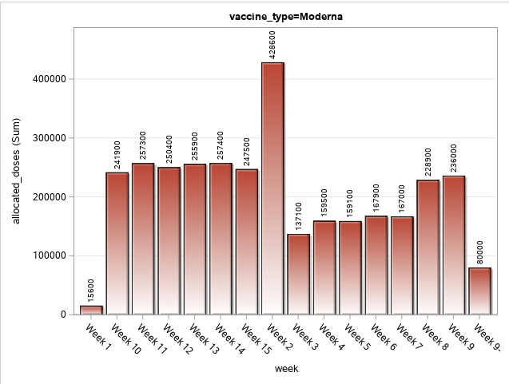
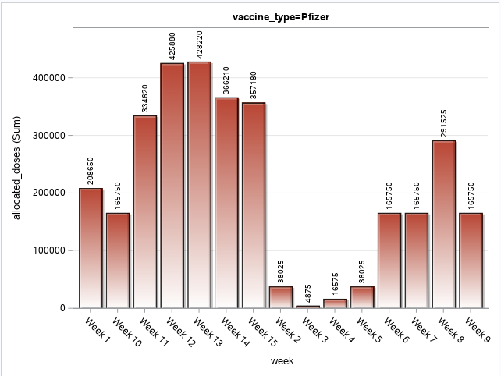
Moderna and Pfizer are the most distributed vaccine types across Texas with some varying results week-to-week.

Slide 5
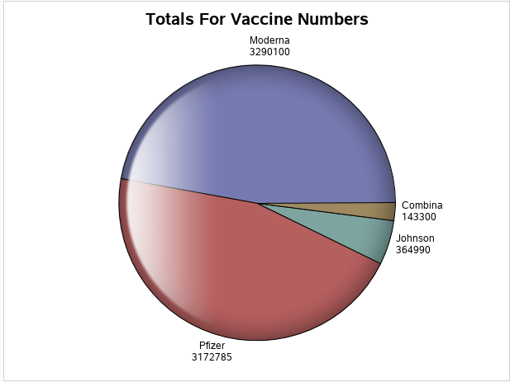
Below are the totals for vaccine by each distributor showing that Johnson and Combina are not used nearly as often.

Slide 6
Conclusion
Everyone reacts to COVID-19 differently, and you're not just protecting yourself.
Texas has now opened vaccinations up to everyone over the age of 16.
If you would like the vaccine, there are vaccine locator tools to help you find a location near you.
Your second dose should be scheduled 3 to 6 weeks after your first dose.
Do your own research when in doubt.

Slide 7
Work Cited
“COVID-19 Vaccine Information.” Texas Department of State Heealth Services, www.dshs.texas.gov/covidvaccine. Accessed 1 Apr. 2021.
Sengottuvel, Rajkumar. “TEXAS COVID-19 Vaccine Allocation and Distribution.” Kaggle, 31 Mar. 2021, www.kaggle.com/rajsengo/texas-covid19-vaccine-allocation.

